Slide 1

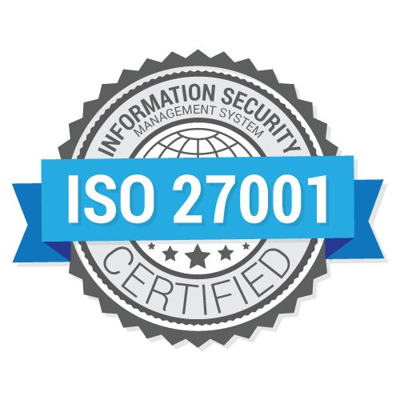

ISO 27001
H.I.M.SAMARANAYAKA
IT20636906

Slide 2
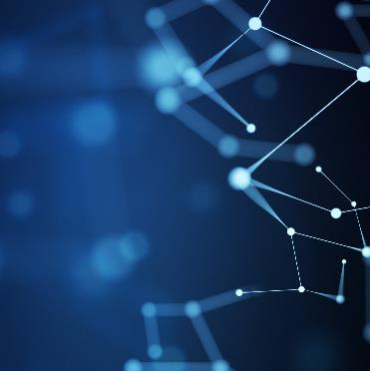


Agenda
What is information and information security
An overview of ISO 27001
Certification process of ISO 27001
Benefits of ISO 27001
Comparing ISO 27001:2013 & ISO 27001:2022

Slide 3
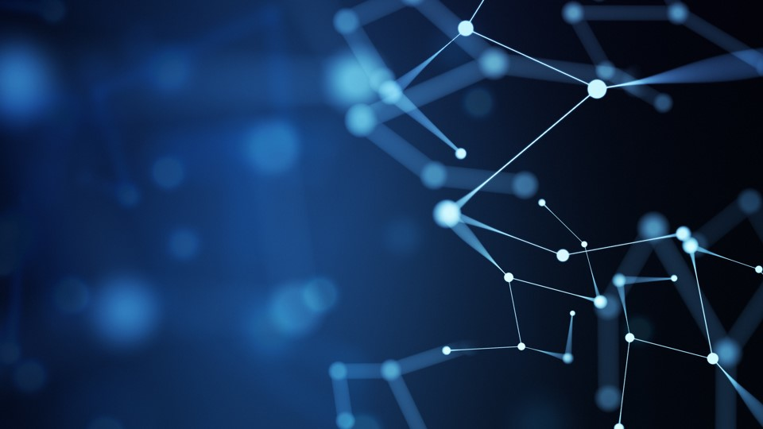
What is Information?
Information is an asset. Information is an asset that have a value.
Employee information
Customer information
Research information.
Finance information.
Email data
Information exists in many forms.
Printed on documents.
Electronically stored data.
Data written on papers.

Slide 4
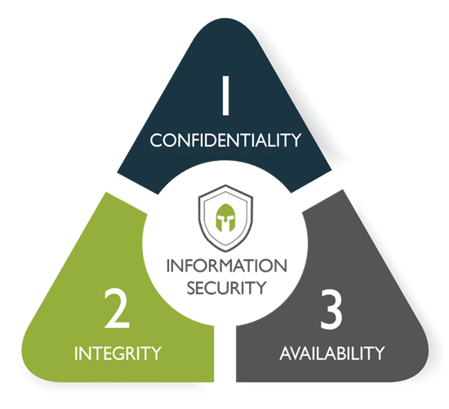

What is information security?
Information security (InfoSec) is the process of protecting information by reducing risks which are associated with information.
Ensure Confidentiality, Integrity and Availability of Information.

Slide 5
Importance of Information Security?
Help the organization to protect information against various threats.
Helps in maintaining privacy and comply with laws and regulations.
Contributes to business continuity.
Help the organization to minimize financial impacts and other kind of various impacts.
It safeguards the technologies used by the organization.

Slide 6
How to secure information?
Final thoughts
Keep some data off the network
Use external service providers carefully
Use access controls and firewalls
Communicate data securely
Encrypt data
Implement a data security plan

Slide 7
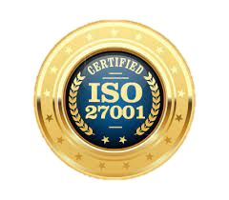

Solution is ISO 27001

Slide 8
What is ISO 27001?
It is a framework that helps organizations to protect and manage information assets in order to protect them.
It helps to create a robust Information Security management system.
It provides a set of controls that can be used to protect information.
Requires to perform risk analysis periodically and top management commitment.
Ensure confidentiality, Integrity, Availability.

Slide 9
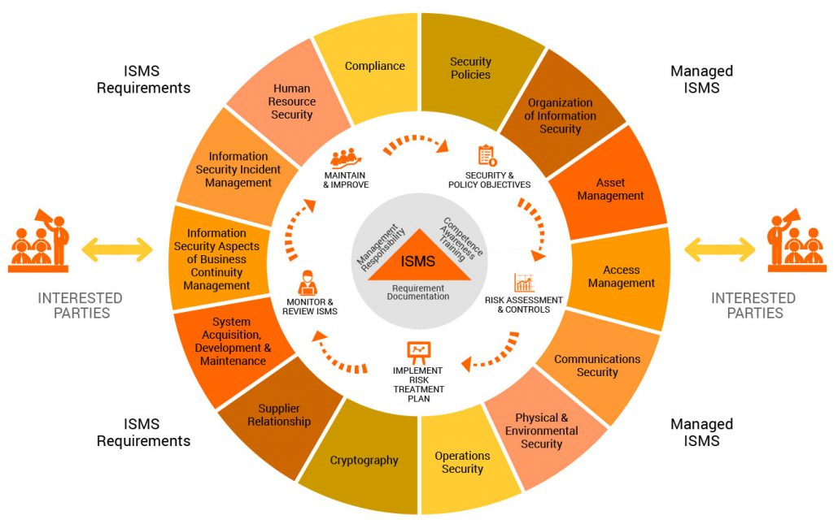
ISO 27001 -
14 control areas
34 control objectives
114 control methods

Slide 10
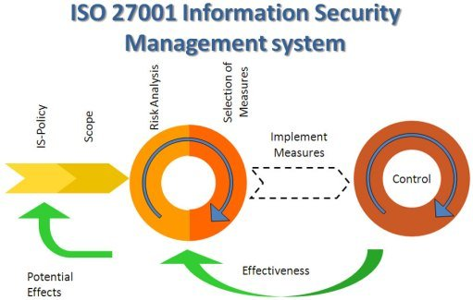
What is ISMS
It is a systematic approach that helps in managing sensitive information of the company with the goals of securing them from threats.
An ISMS is a holistic approach to securing the confidentiality, integrity, and availability (CIA) of corporate information assets.

Slide 11
Benefits of ISO 27001
Gain new customers and contributes to competitive advantage.
Customer satisfaction.
Improve structure and focus.
Protects and strengthen the reputation.
Protects your data no matter where the data is stored.

Slide 12
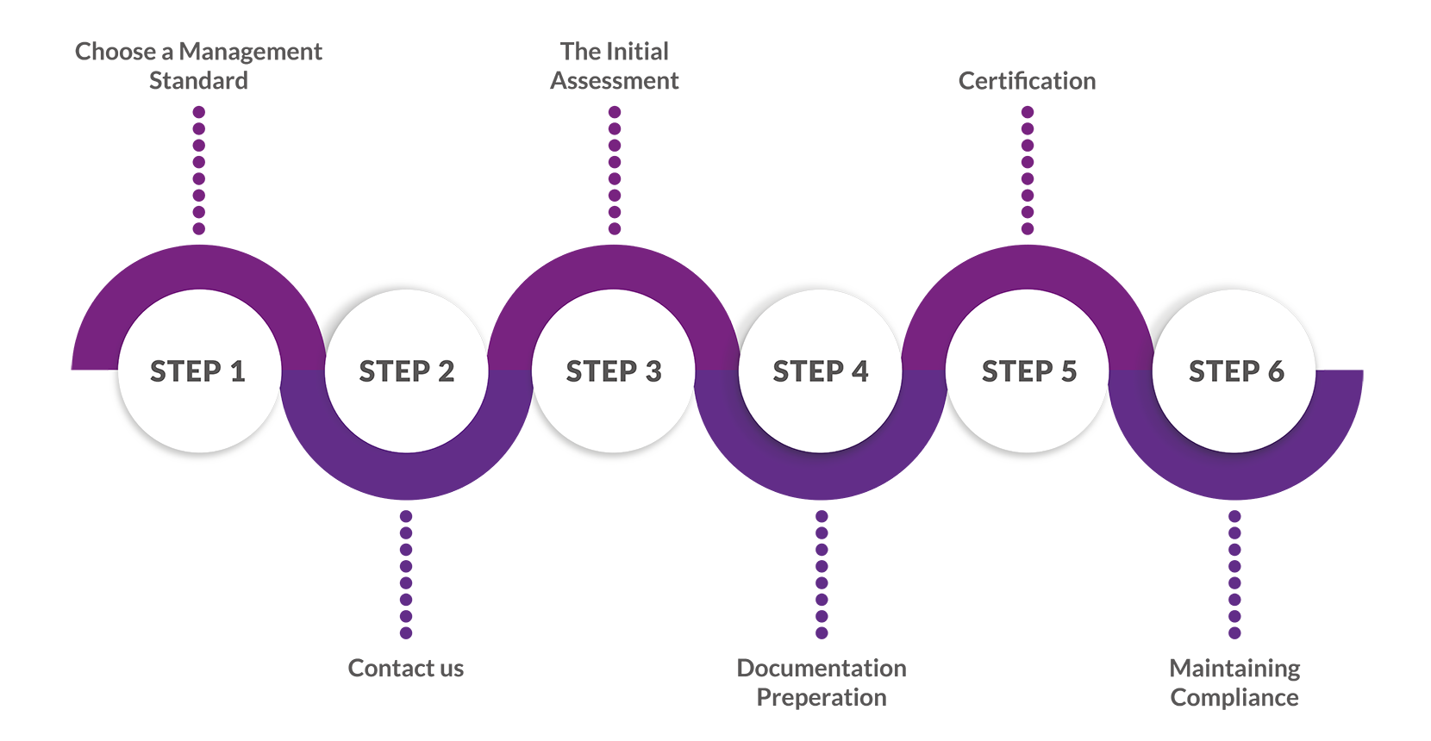
Certification process of ISO 27001

Slide 13
ISO 27001:2013 vs 27001:2022
The main part of ISO 27001, i.e., clauses 4 to 10, has changed only slightly.
The changes in Annex A security controls are moderate.
The number of controls has decreased from 114 to 93.
The controls are placed into 4 sections, instead of the previous 14.
There are 11 new controls, while none of the controls were deleted, and many controls were merged.

Slide 14
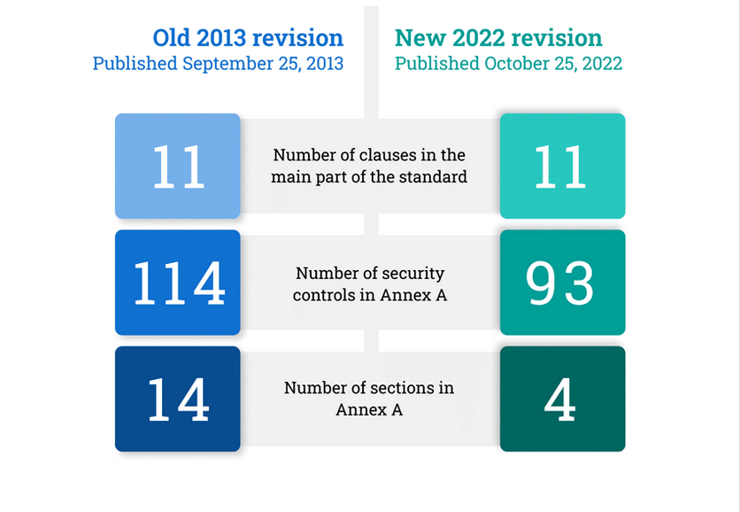
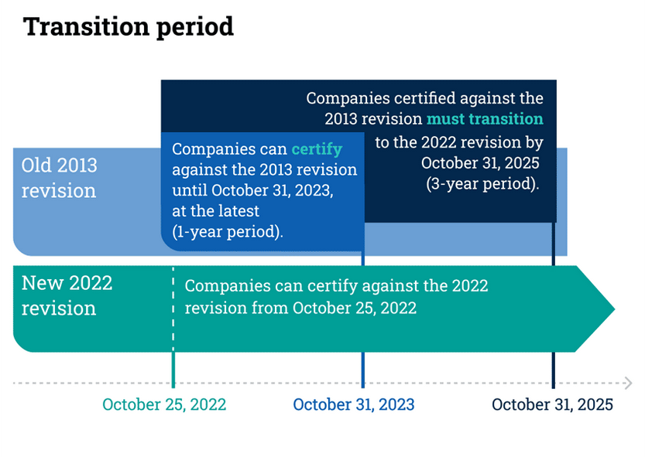
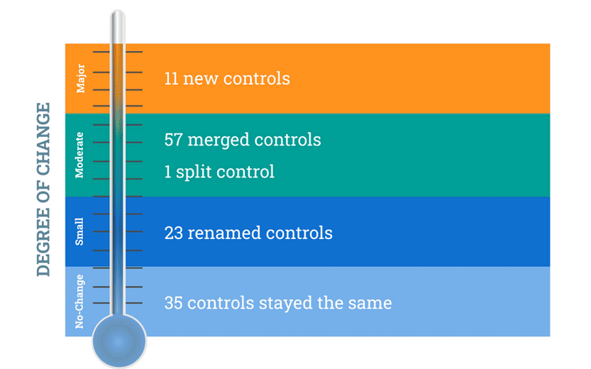
How Differ from the version to version -

Slide 15

Summary
The ISO 27001 standard provides the framework for an effective Information Security Management System (ISMS). It sets out the policies and procedures needed to protect your organisation. It includes all the risk controls (legal, physical and technical) necessary for robust IT security management.

Slide 16
Resources
https://www.itgovernance.co.uk/iso27001
https://www.isms.online/iso-27001/4-key-benefits-of-iso-27001-implementation/
https://ostec.blog/en/general/iso-27001/
https://www.google.com/search?client=firefox-b-d&q=summary+for+iso+27001+implementation
https://store.legal.thomsonreuters.com/law-products/news-views/corporate-counsel/tips-for-protecting-your-organizations-data
https://secureframe.com/blog/iso-27001-statement-of-applicability

Slide 17
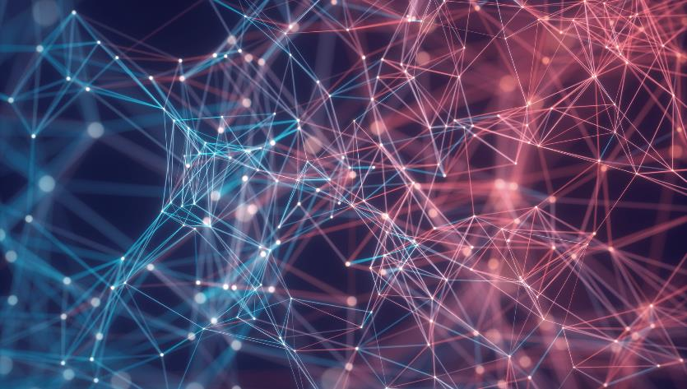
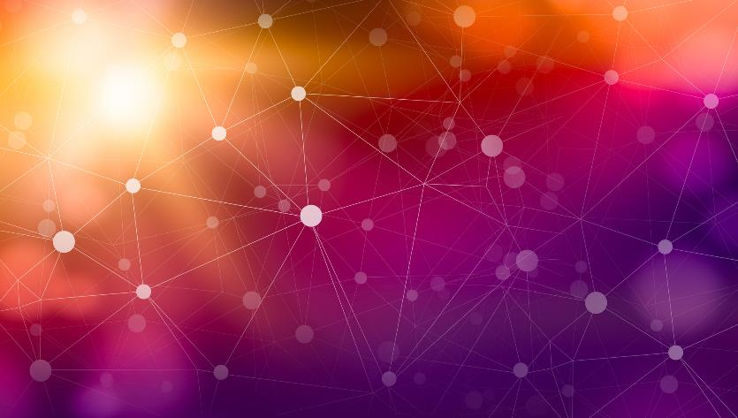
Thank You
H.I.M.SAMARANAYAKA
it20636906@my.sliit.lk
https://medium.com/@it20636906/what-is-iso27001-3658149f9d70

